Slide 1
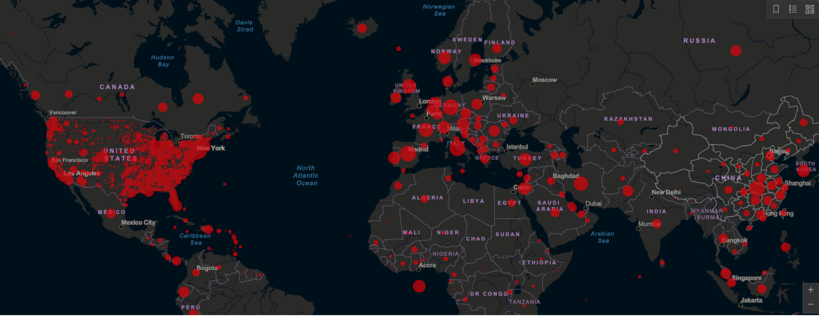

Covid Hackathon
Team: Order of Phoenix
Notes:
Order of phoenix

Slide 2


Introduction
Target
Relevance: US has the highest number of CoVID cases in the world. We aim to take a closer look at states and perform prescriptive analytics to mitigate the spread
Problem statement : We want to help the decision makers by providing recommendations based on current trends in the state based on medial and non-medical interventions.
We aim to find demographic factors, hospital resources and mobility data. Basis our visualizations and analysis, we present recommendations for controlling the spread of the diseases in states that currently do not have a high number of cases
Medical Professionals
Government Leaders
Notes:
Business Case: What was your main objective for this project? Were there any specific questions that you tried to answer? What kind of social/business impact did you expect? Why did you think the problems that you’re trying to solve are important to the public, to the community, to health care professionals, to policymakers or even more? A good business case:
Has a clearly defined problem statement, background, and motivation.
Has a clear understanding of the potential impact while defining the business question(s).
Has the strong potential to make a positive societal/business impact.

Slide 3
Business objective - Recommendations to flatten the curve
Methodology
The factors affecting the spread of COVID-19 can be divided into:
Pharmaceutical measures
Hospital beds
ICU beds
Ventilators/Invasive ventilators
Non-pharmaceutical measures
Social distancing
Demographics
Age group
Race
Gender
Exploratory Data Analytics
Problem statement
Machine Learning model
Define KPI
Measure success
Notes:
Giving examples on

Slide 4
Data Sources
Census Data
IHME Data
Google Mobility
Wikipedia
NY Times articles
Worldometer.com
Dataset Details
Age-group, Race, Median age, population density data for every US state
Google mobility data - Grocery & Pharmacy, Parks, Residential, Retail & Recreation, Transit stations, Workplaces for 50 US states
Medical resources - Extra beds, ICU beds required for each state
Notes:
https://www.nytimes.com/interactive/2020/us/coronavirus-stay-at-home-order.html

Slide 5
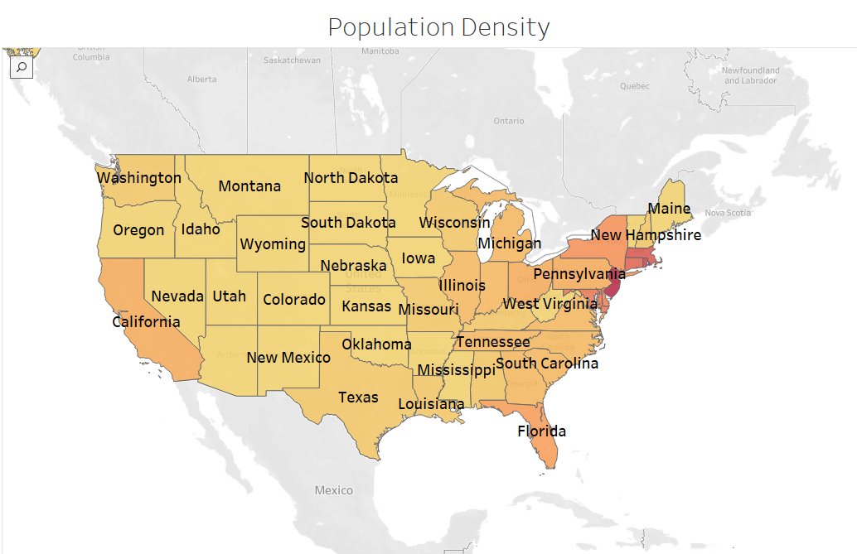
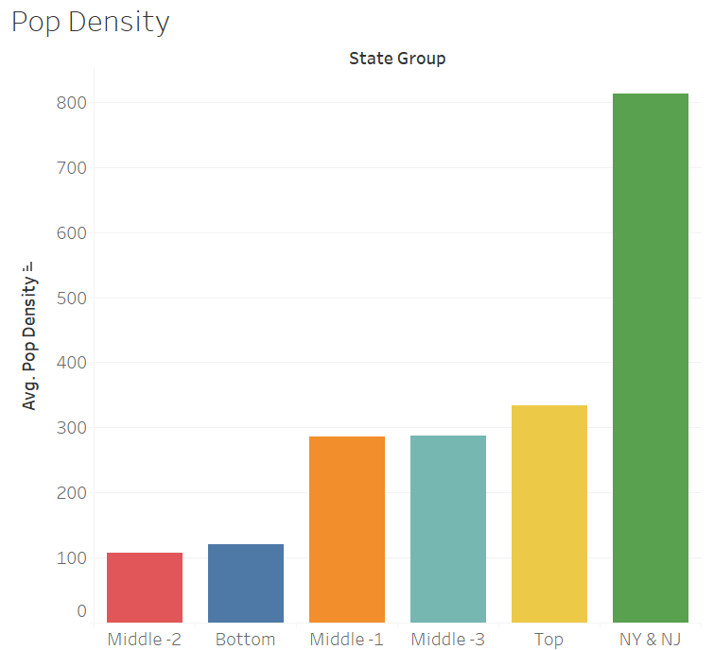
EDA : Our findings
We divided the 50 states into subgroups based on the number of COVID-19 cases
High correlation between number of COVID - 19 cases and population density of state
Notes:
Sub-groups - NY & NJ have the highest number of cases, followed by Top group, Middle-1, Middle-2, Middle-3 and then Bottom

Slide 6
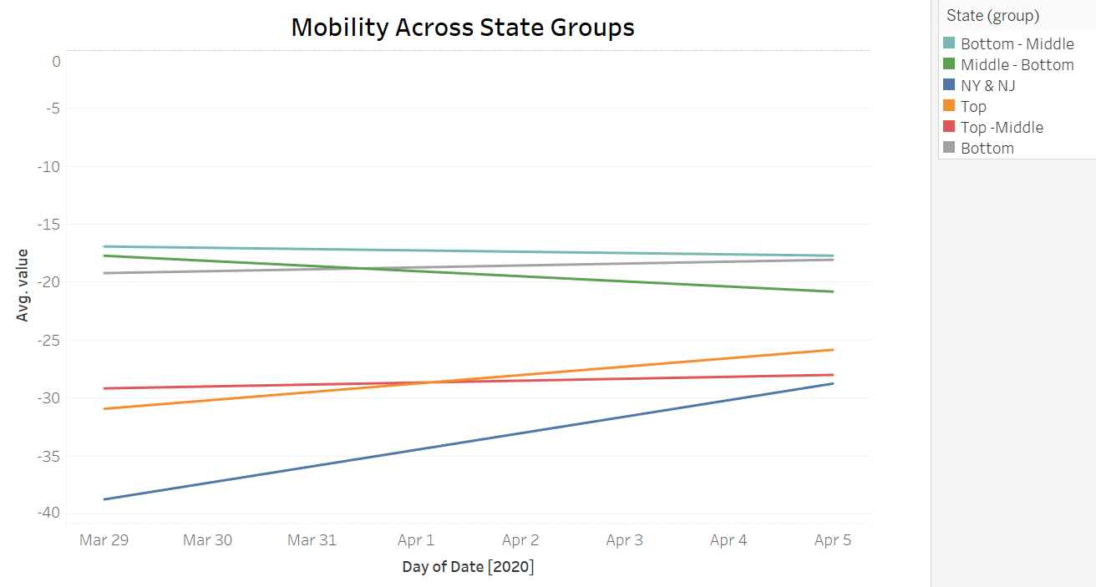
EDA : Our findings
We found that overall mobility has not decreased as much compared to the baseline in bottom states, i.e. states with lower number of coronavirus cases at the moment
Notes:
Baseline is the median value, for the corresponding day of the week, during the 5- week period Jan 3–Feb 6, 2020.

Slide 7
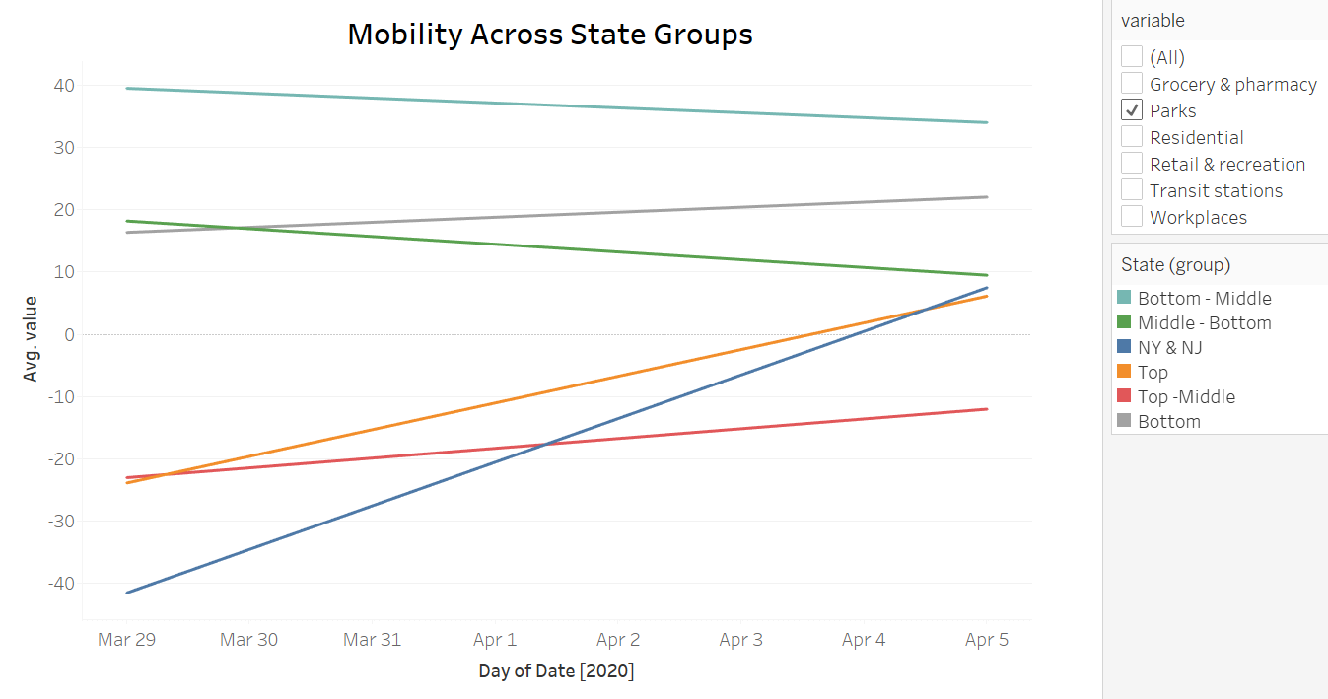
EDA : Our findings
Mobility has INCREASED in parks, among the states with lower coronavirus cases. Parks are defined as public places such as national parks, public beaches, marinas, dog parks, plazas, and public gardens.
Notes:
Sub-groups - NY & NJ have the highest number of cases, followed by Top group, Middle-1, Middle-2, Middle-3 and then Bottom

Slide 8
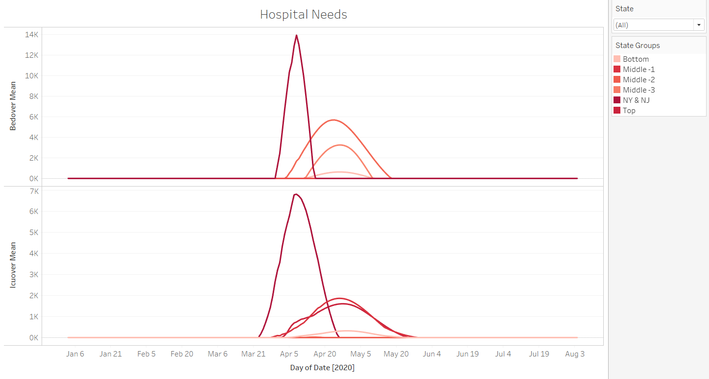
EDA : Our findings
There’s a high correlation between the number of beds and ICU beds required and the number of cases
Notes:
Bedover = [covid all beds needed] - ([total bed capacity] - [average all bed usage])
ICUover = [covid ICU beds needed] - ([total ICU capacity] - [average ICU bed usage])

Slide 9
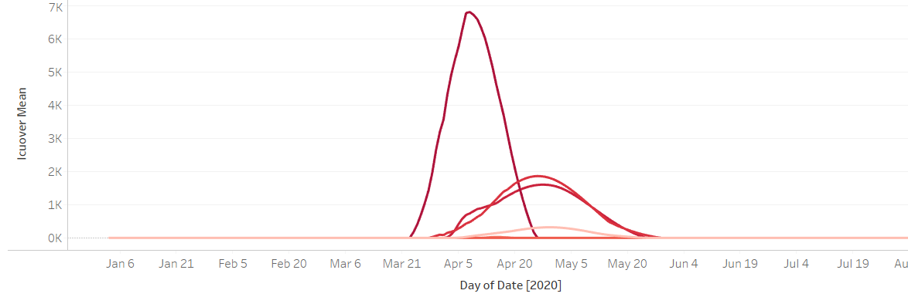
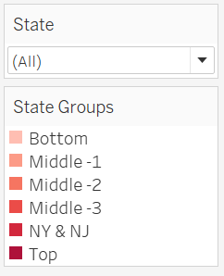
EDA : Our findings
We can see that the requirement for ICU beds in tates with medium number of cases is as high as that in states with maximum number of COVID cases
Middle
Top
Notes:
Bedover = [covid all beds needed] - ([total bed capacity] - [average all bed usage])
ICUover = [covid ICU beds needed] - ([total ICU capacity] - [average ICU bed usage])

Slide 10
Modeling methodology
Since the number of Covid cases are increasing in a timeseries
There fore we used a state-space model to estimate the total number of beds required per state (including ICU beds)
The model uses a flexible timeframe to predict the number of beds required. We have set the timeframe to a week which means we can predict the number of beds required for next week.
For the implementation we have looked at the timeseries state space model using autoregression.

Slide 11
Our KPI
KPI - Predicting beds within error margin of 100 beds
Results –
In sample Mean square error is 64
Out of sample Mean square error is 85
Interpretation of the KPI:
At any point the predicted number of beds (also correlated with infections) is at most off by a 100 number
This is easy to explain to the professional stakeholders and the leaders

Slide 12
Recommendations
Our target audience: Governments and medical authorities of states with currently lower number of COVID case, we want to help them learn from other states and avoid widespread of the virus
Recommendations:
Pharmaceutical: No. of hospital beds required for the upcoming 7 days
Non Pharmaceutical: Mobility is a concern in these states, the lockdown is not as effectively being followed, especially in Parks. The government needs to immediately curb movement of its state citizens

